Slide 1

Pet Clinic
Методиј Бужаровски 193155

Slide 2
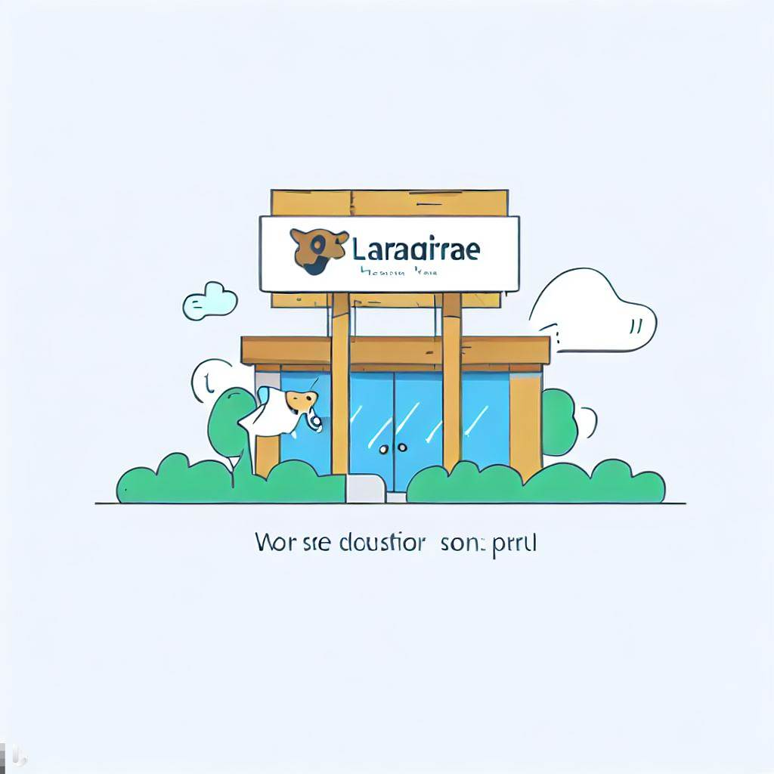
Introduction
The Laravel Pet Clinic project aims to create a comprehensive web application for managing pet-related task. The project scope leverages user authentication, appointment scheduling, pet management, medical records, staff management, a contact form, and a blog

Slide 3
Technologies Used
The project leverages Laravel, a popular PHP framework known for its robustness and ease of use. Other technologies include HTML, CSS, JavaScript, Bootstrap and MySQL for the database.

Slide 4
Key Features
Core features of the application:
User authentication
Appointment scheduling
Pet management
Medical records
Staff management
Contact form
Blog

Slide 5
Database Schema

Slide 6
Demo

